Slide 1


MPA effects on dark diversity
01/05/2023

Slide 2
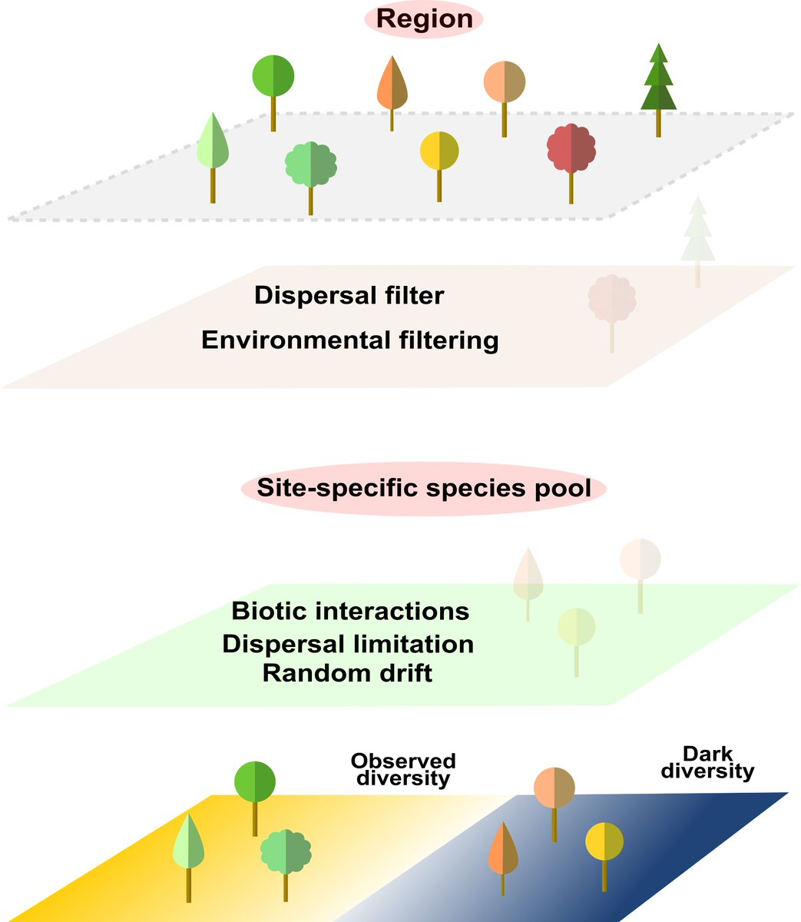
What is dark diversity?
Species that suit the area’s biogeographical, historical, and environmental conditions but missing from the site due to natural or anthropogenic reasons

Slide 3
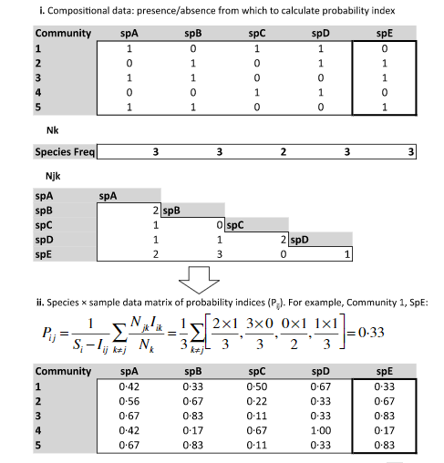
Calculating dark diversity
1
3
Set threshold: For each species calculate what is the mean probability to occur, from surveys where the species actually occurred
4
If the species was missing but its probability to occur was higher than the threshold – Dark Diversity
If the species was missing but its probability to occur was lower than the threshold – not in the DD, we don’t expect to see the species there.
2

Slide 4
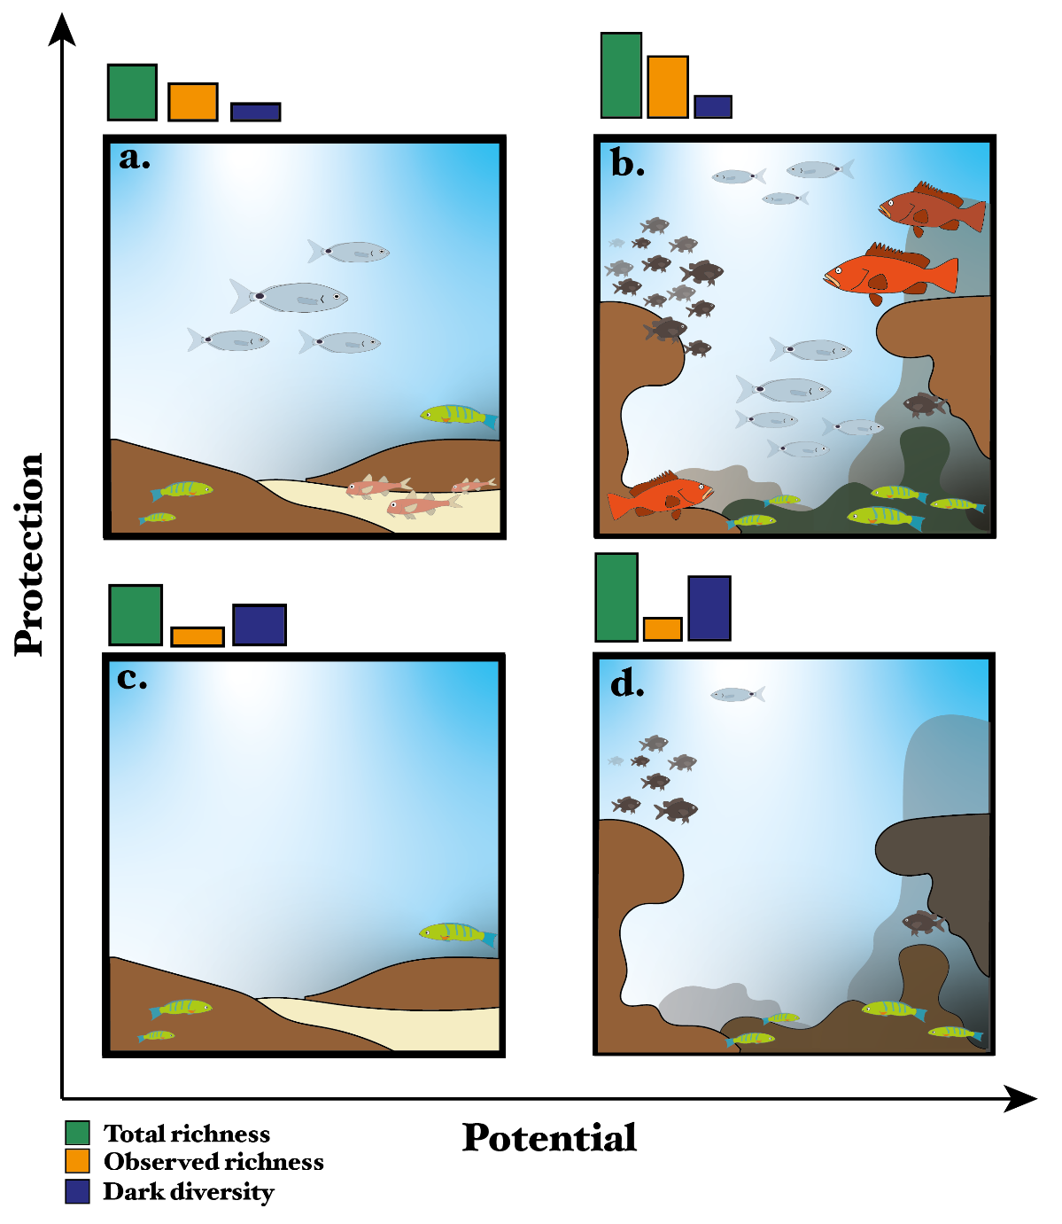
Our hypotheses:
If we add dark diversity to the observed diversity, we will estimate a site-specific species pool that directly reflects site quality.
In PAs located in high-quality habitats, we expect to see high richness and low dark diversity as most species that can live in that area will be present locally (Fig 1B).
In sites outside of PA but of similar quality, we expect low richness but high dark diversity, summing to similar species to that found in the PA (Fig 1D).
In sites outside of PA but of low quality, we expect both low richness and low dark diversity and total richness lower than that found in PA (Fig 1C).

Slide 5
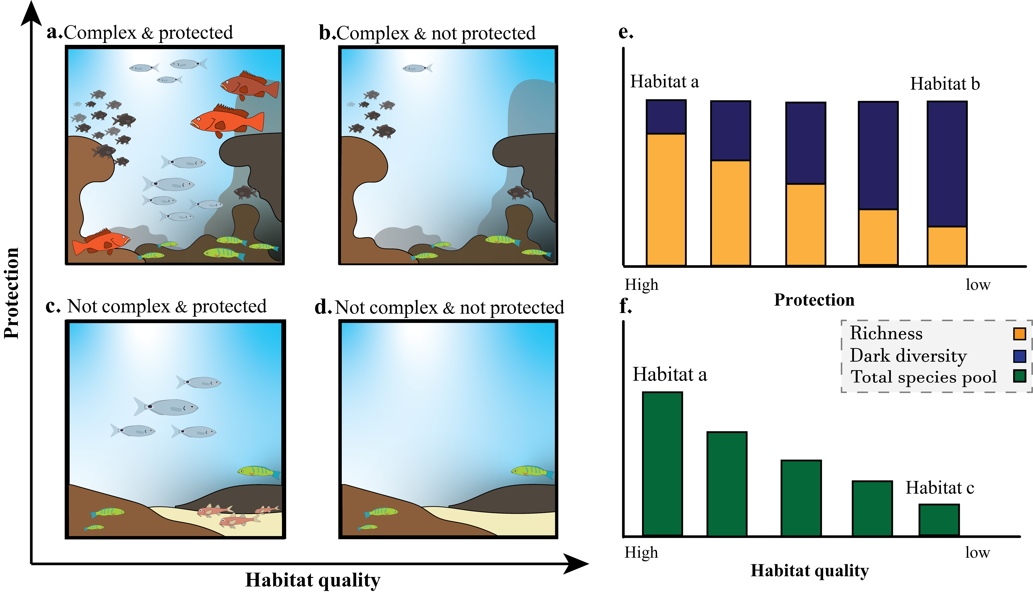
Illustration plot option 2

Slide 6
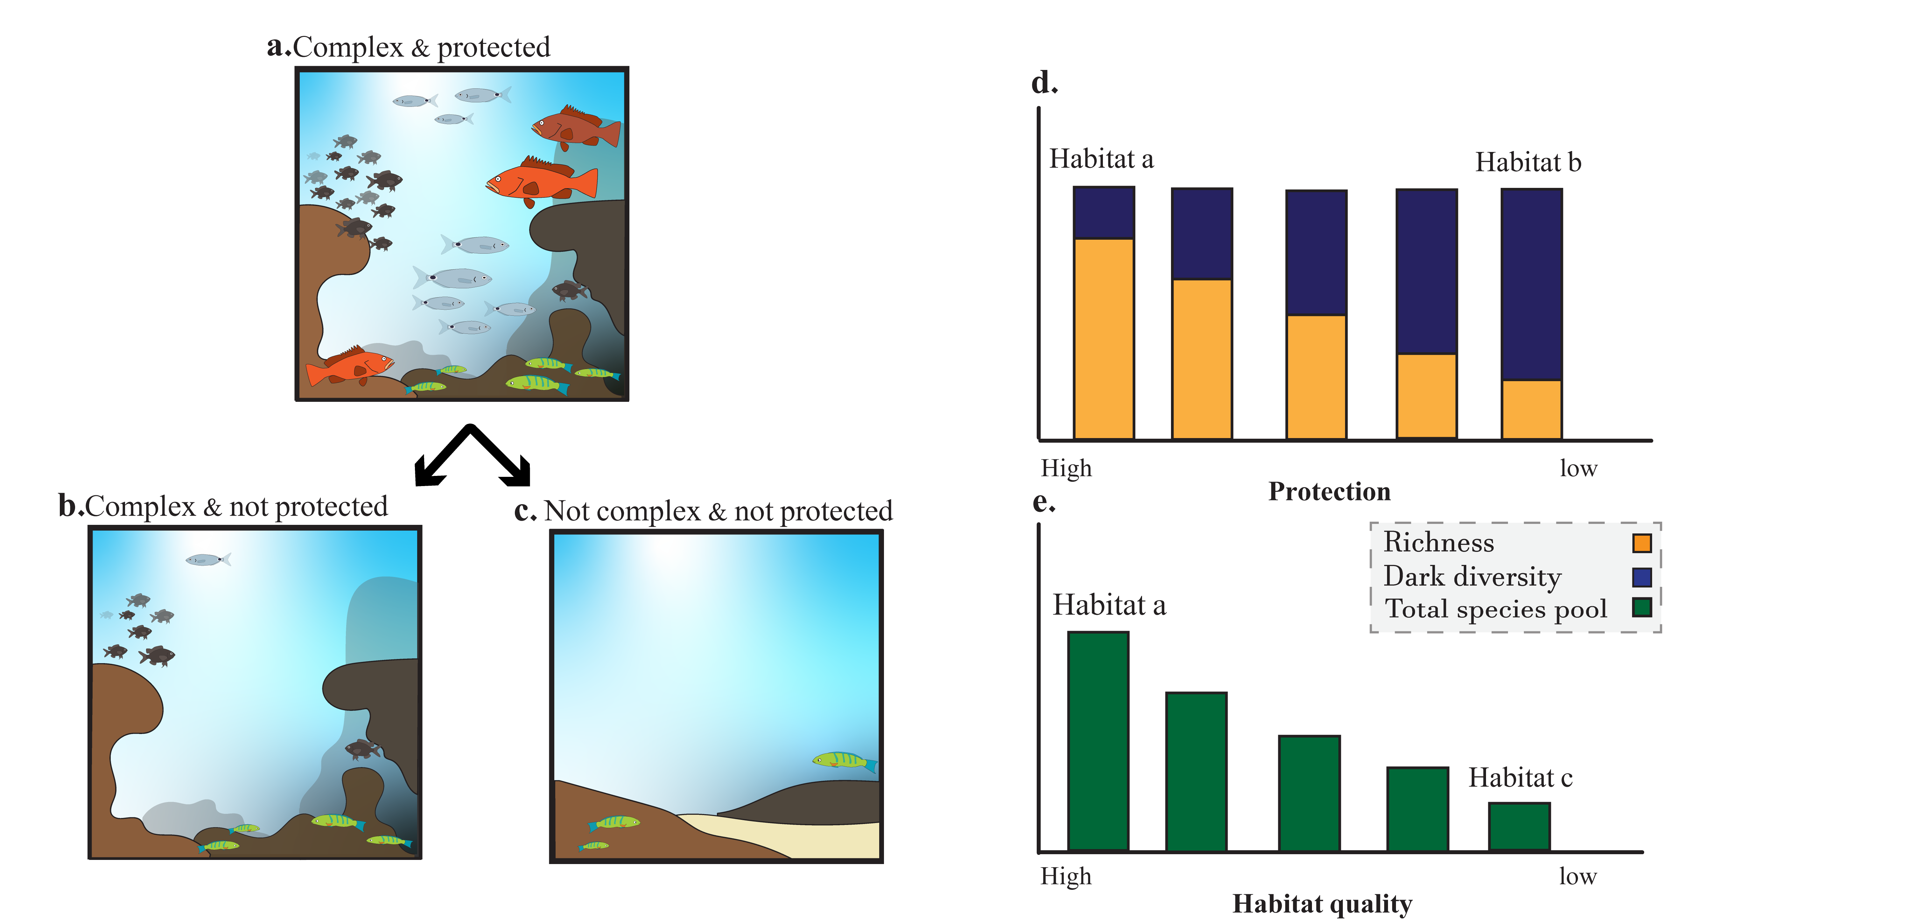
Illustration plot option 3

Slide 7
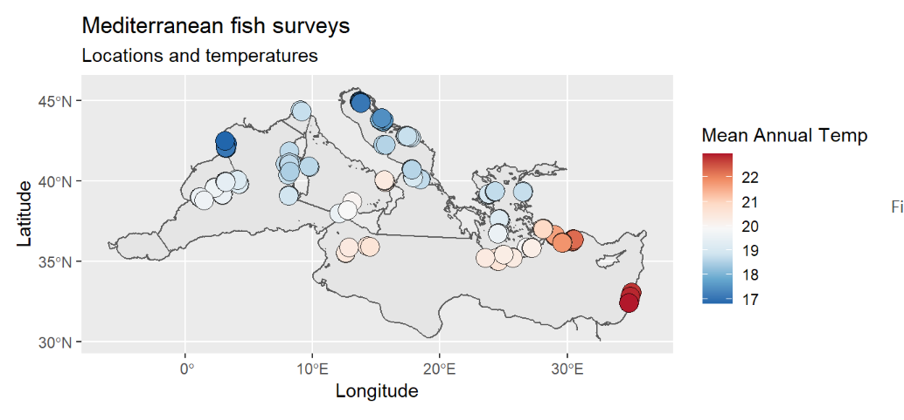
Our data:

Slide 8
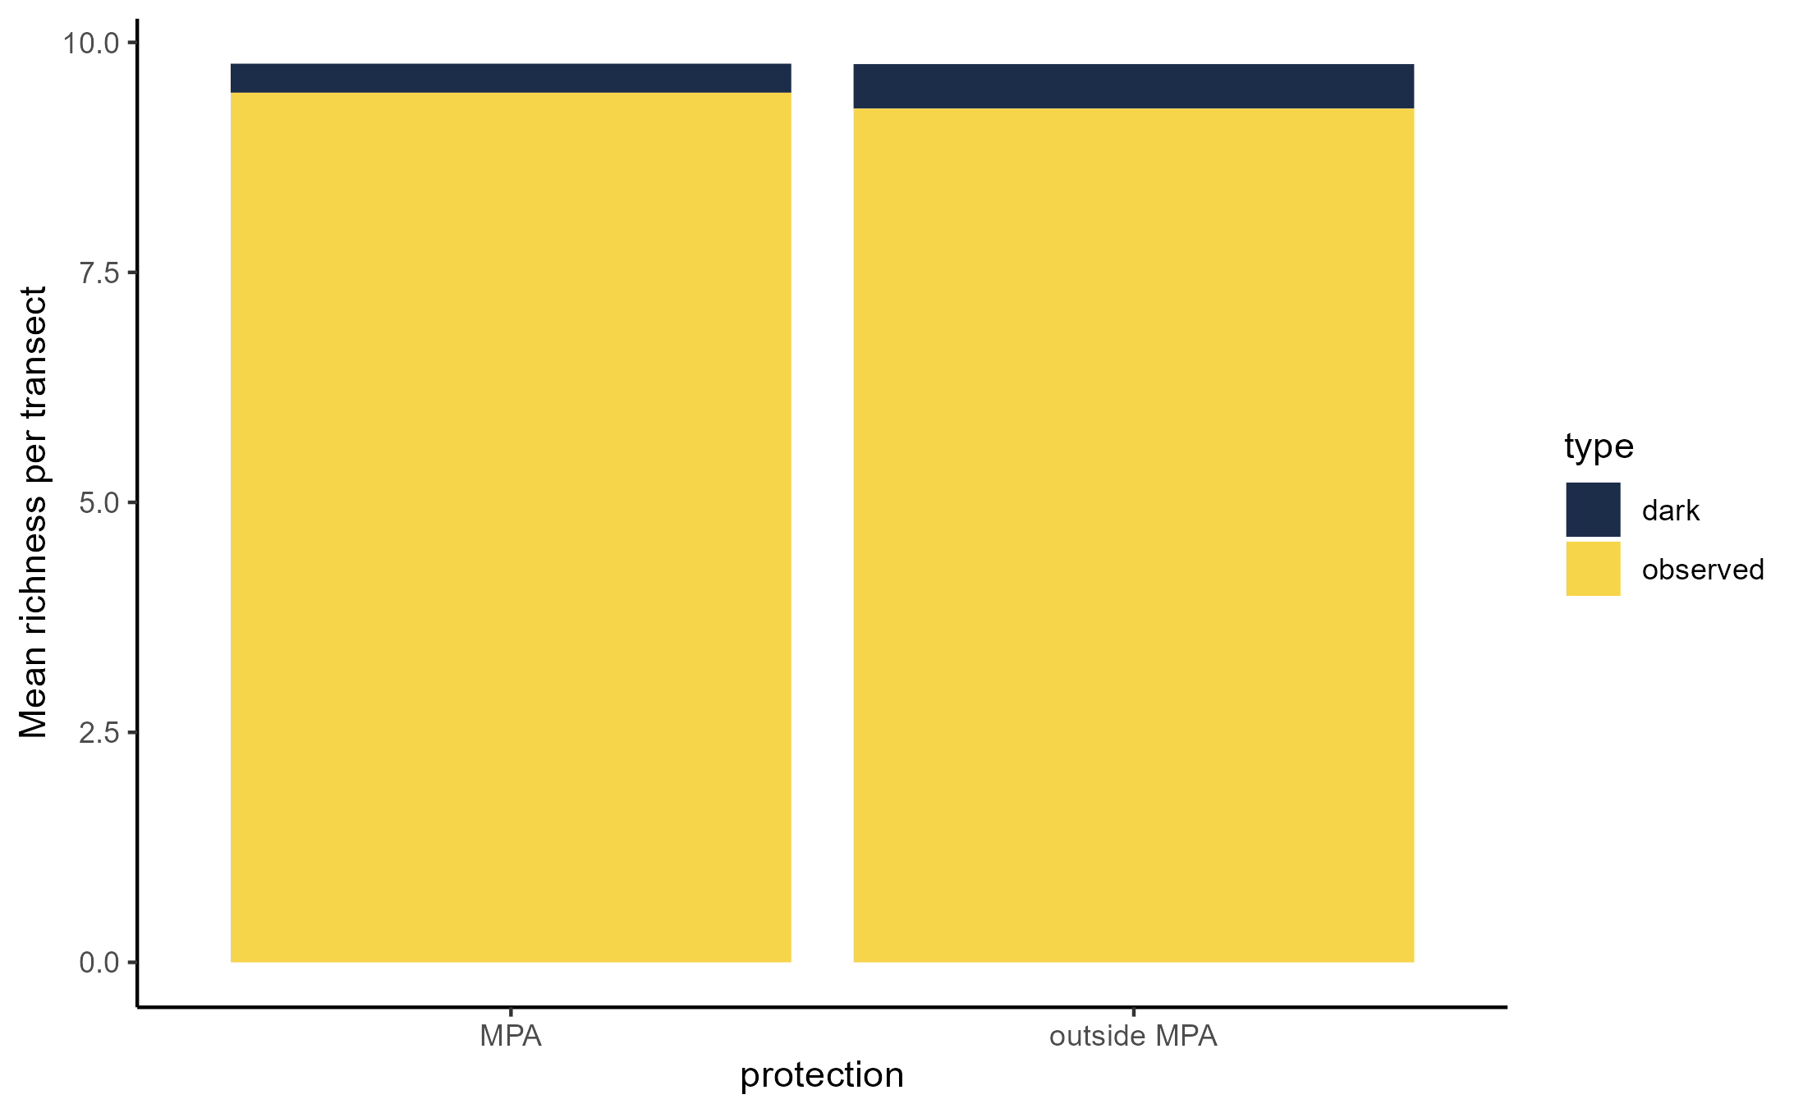
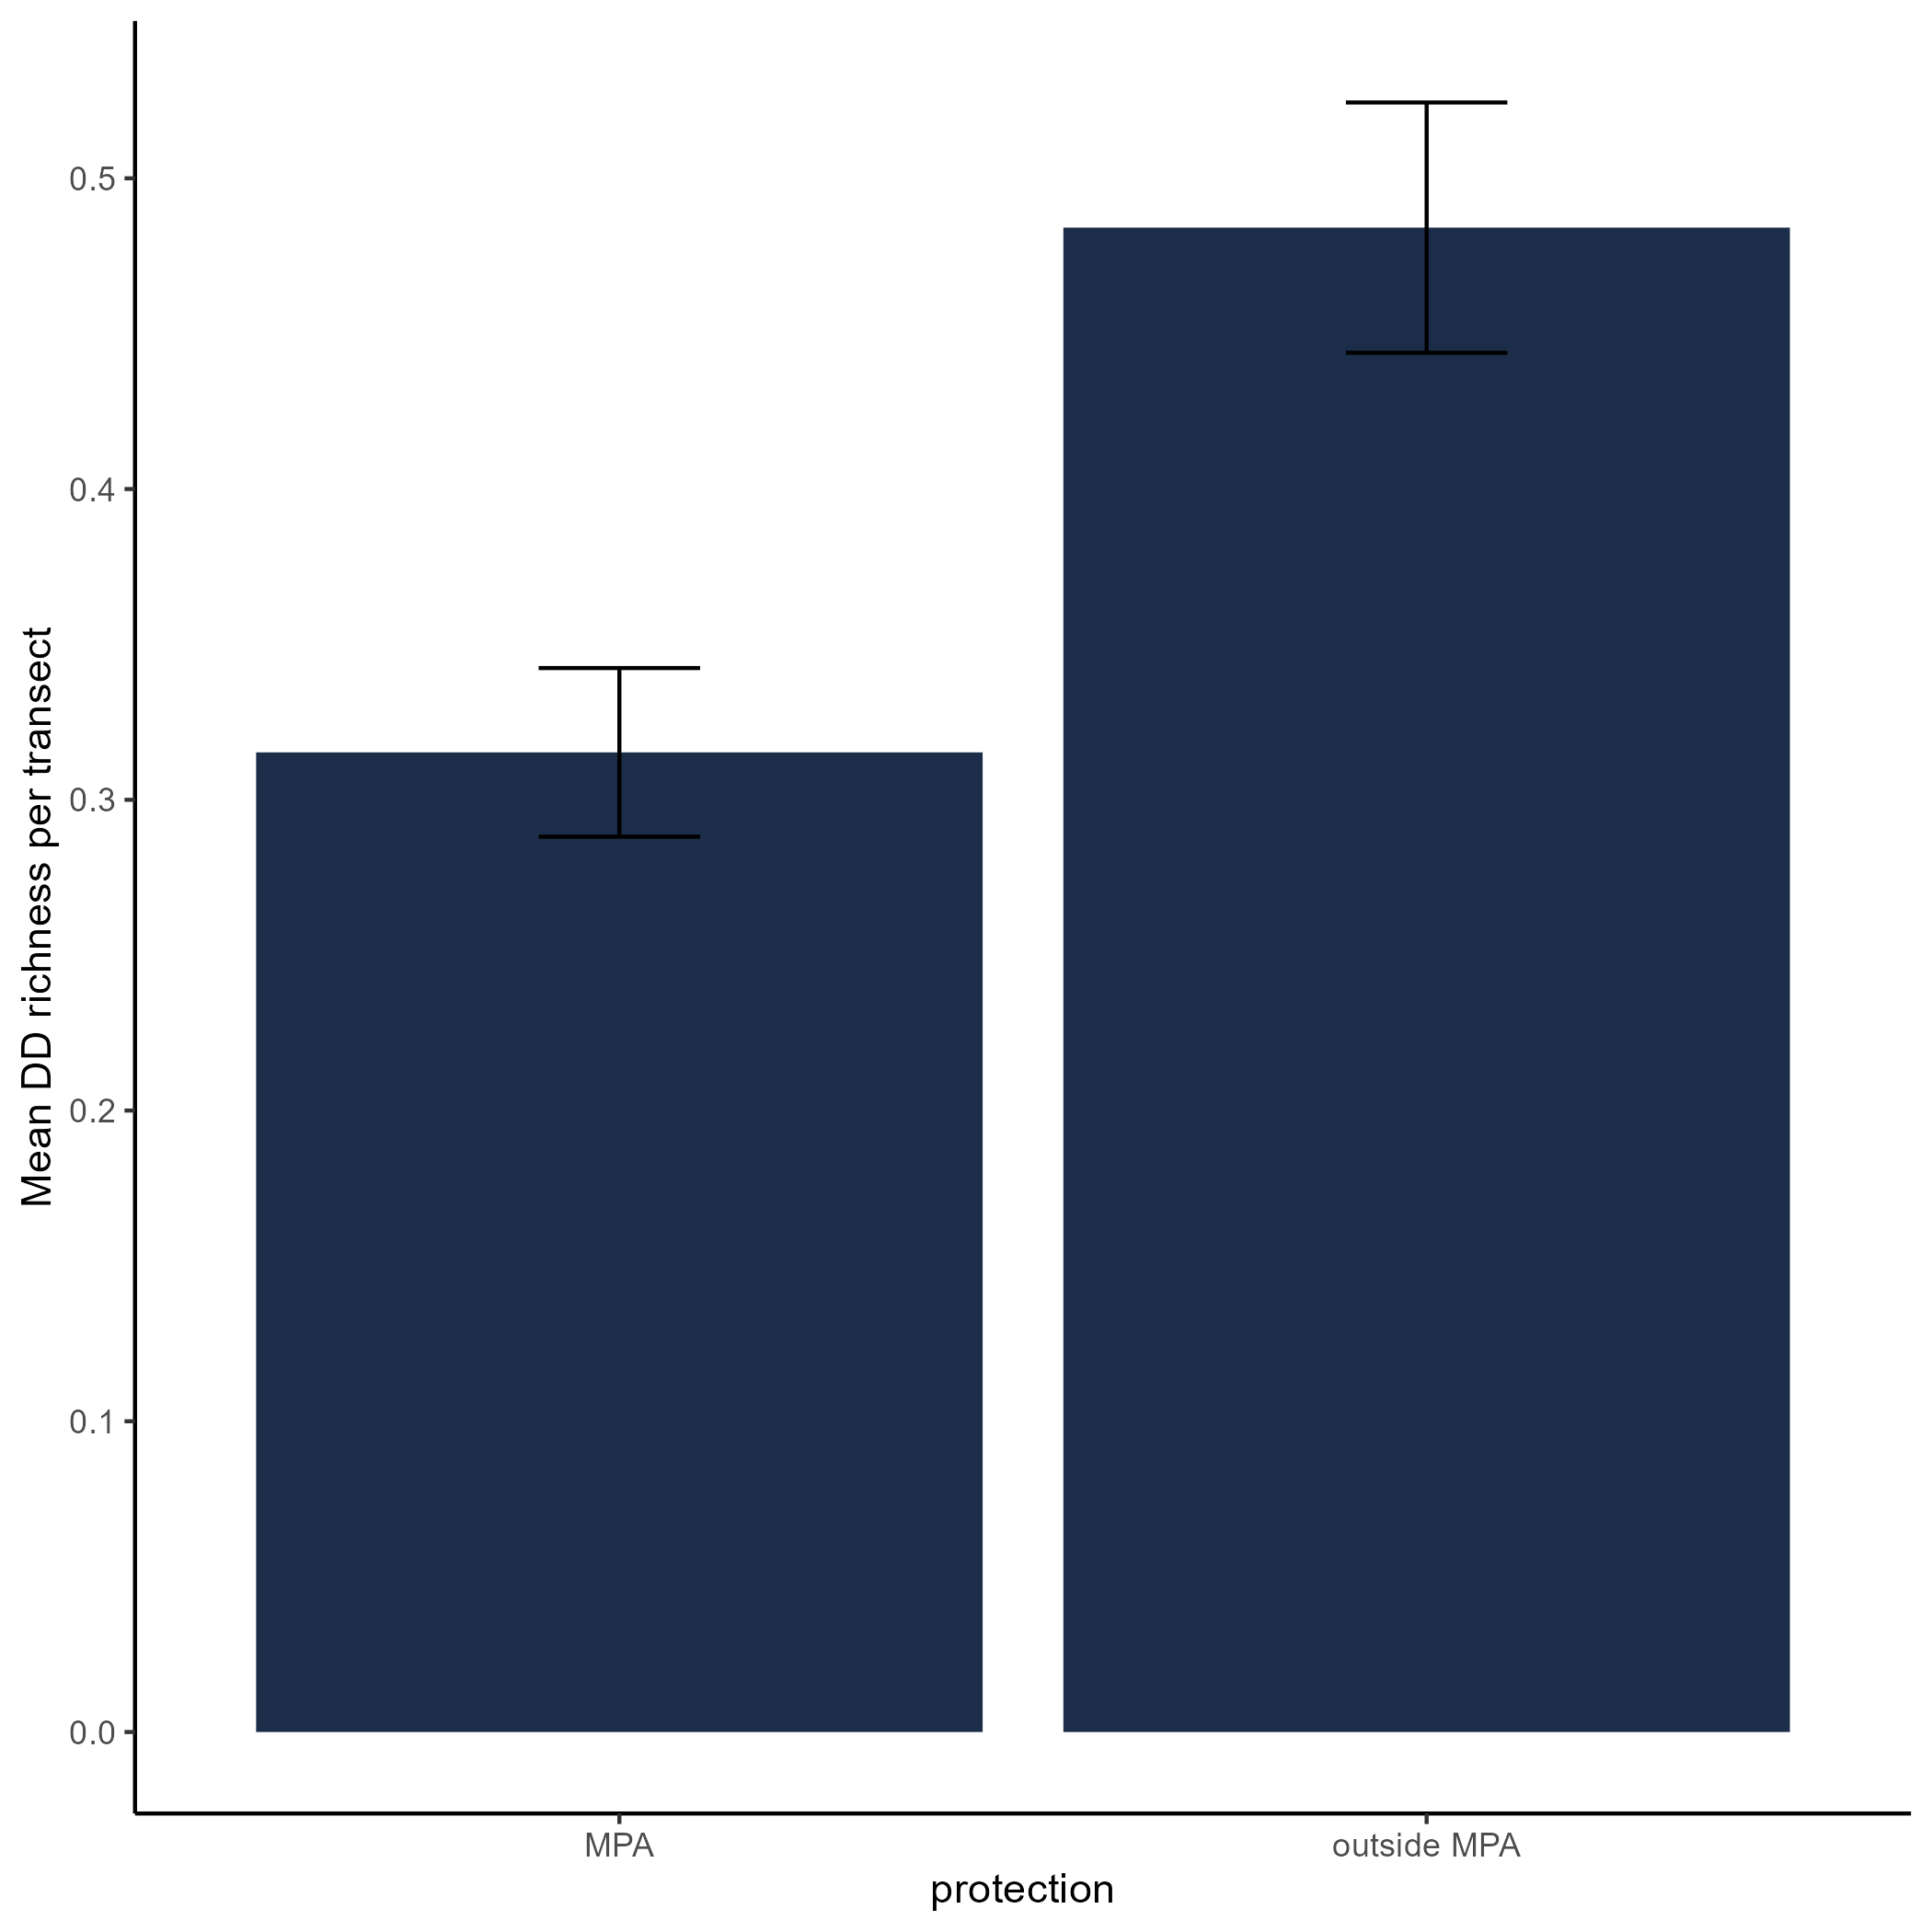
Compering dark diversity in and out of MPAs

Slide 9
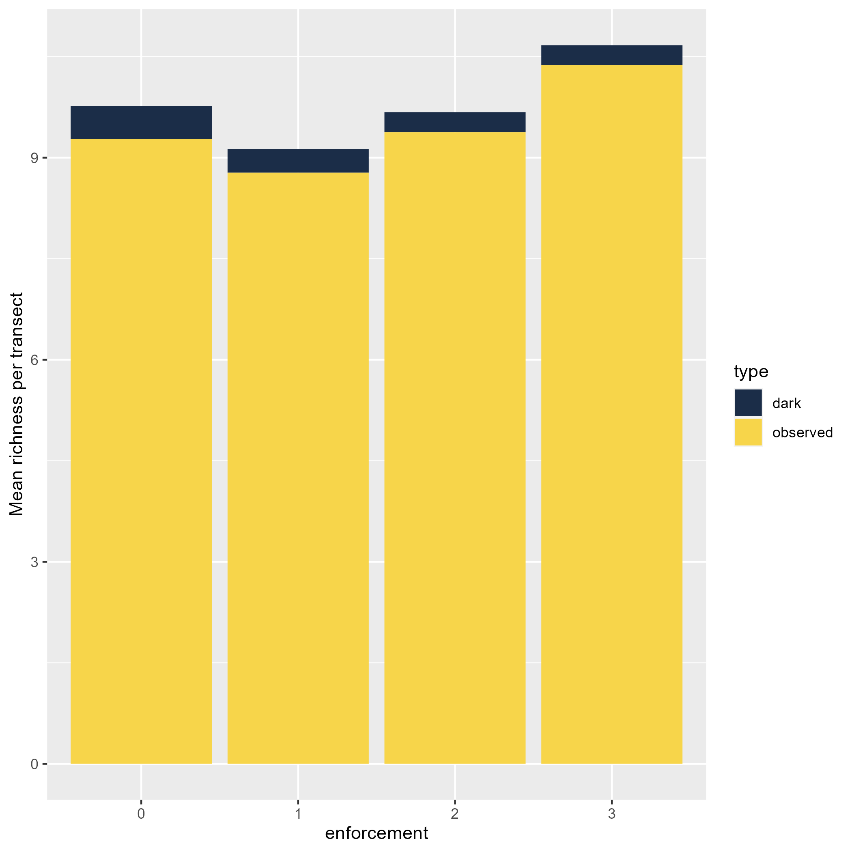
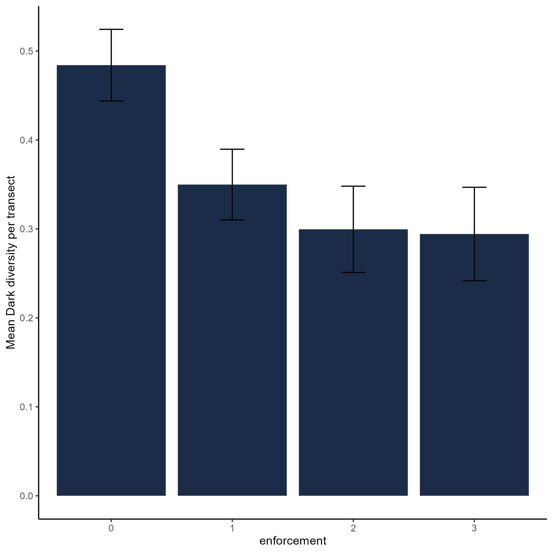
Dark diversity at different protection levels

Slide 10
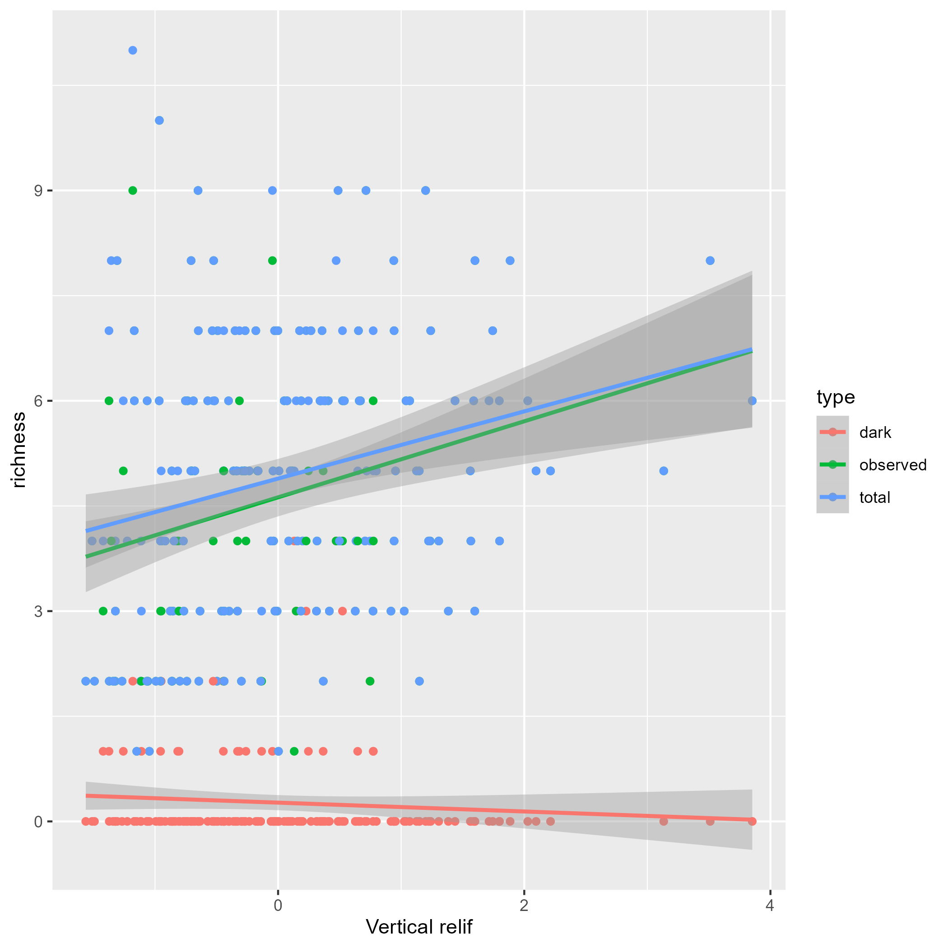
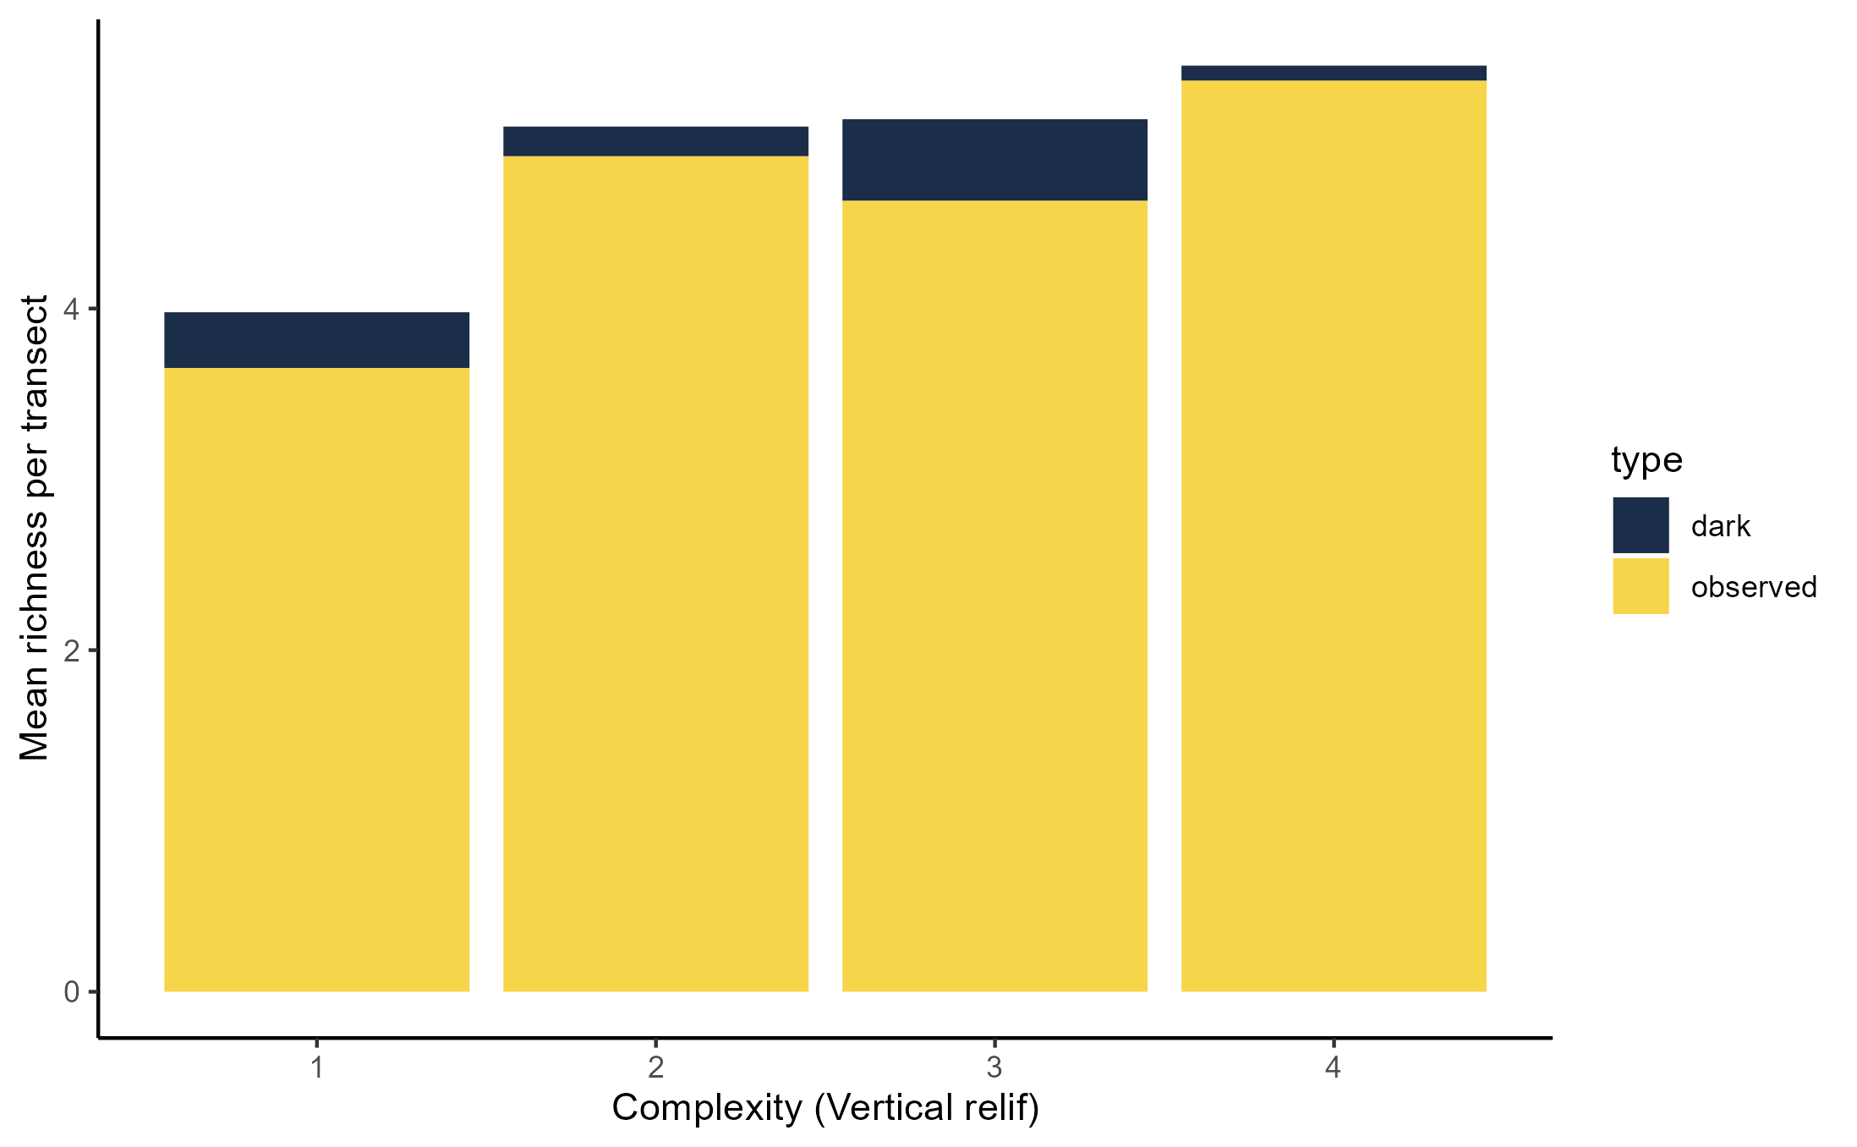
Species pool and complexity – vertical relief

Slide 11
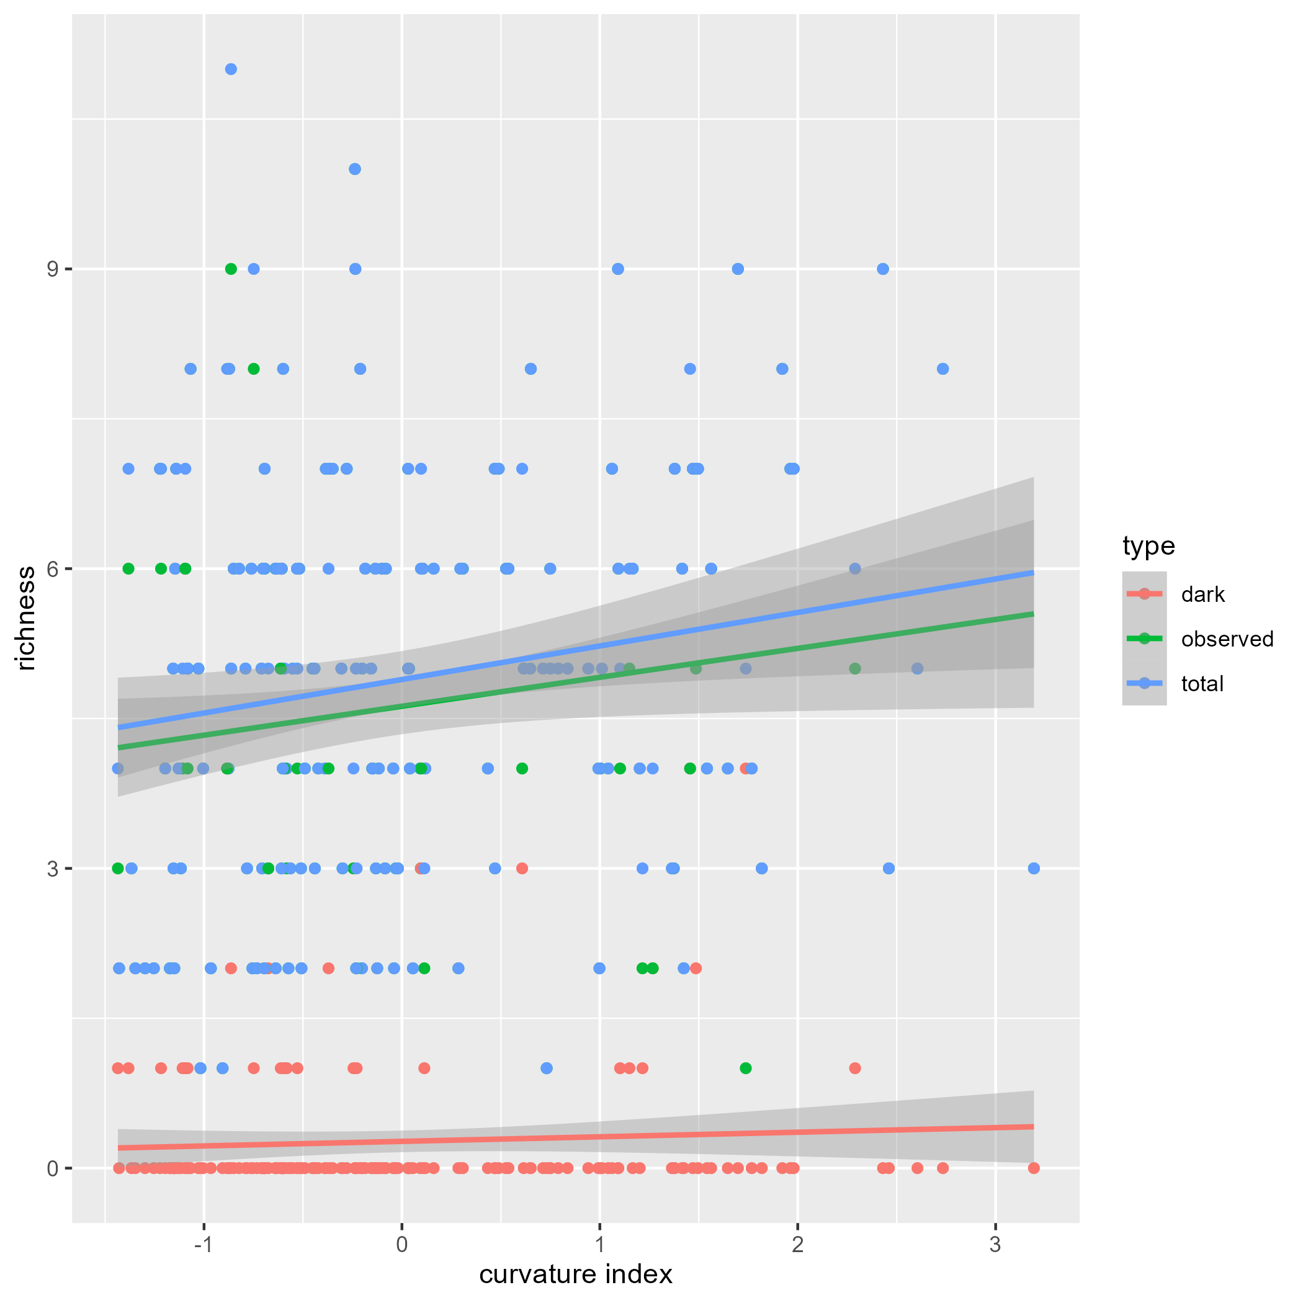
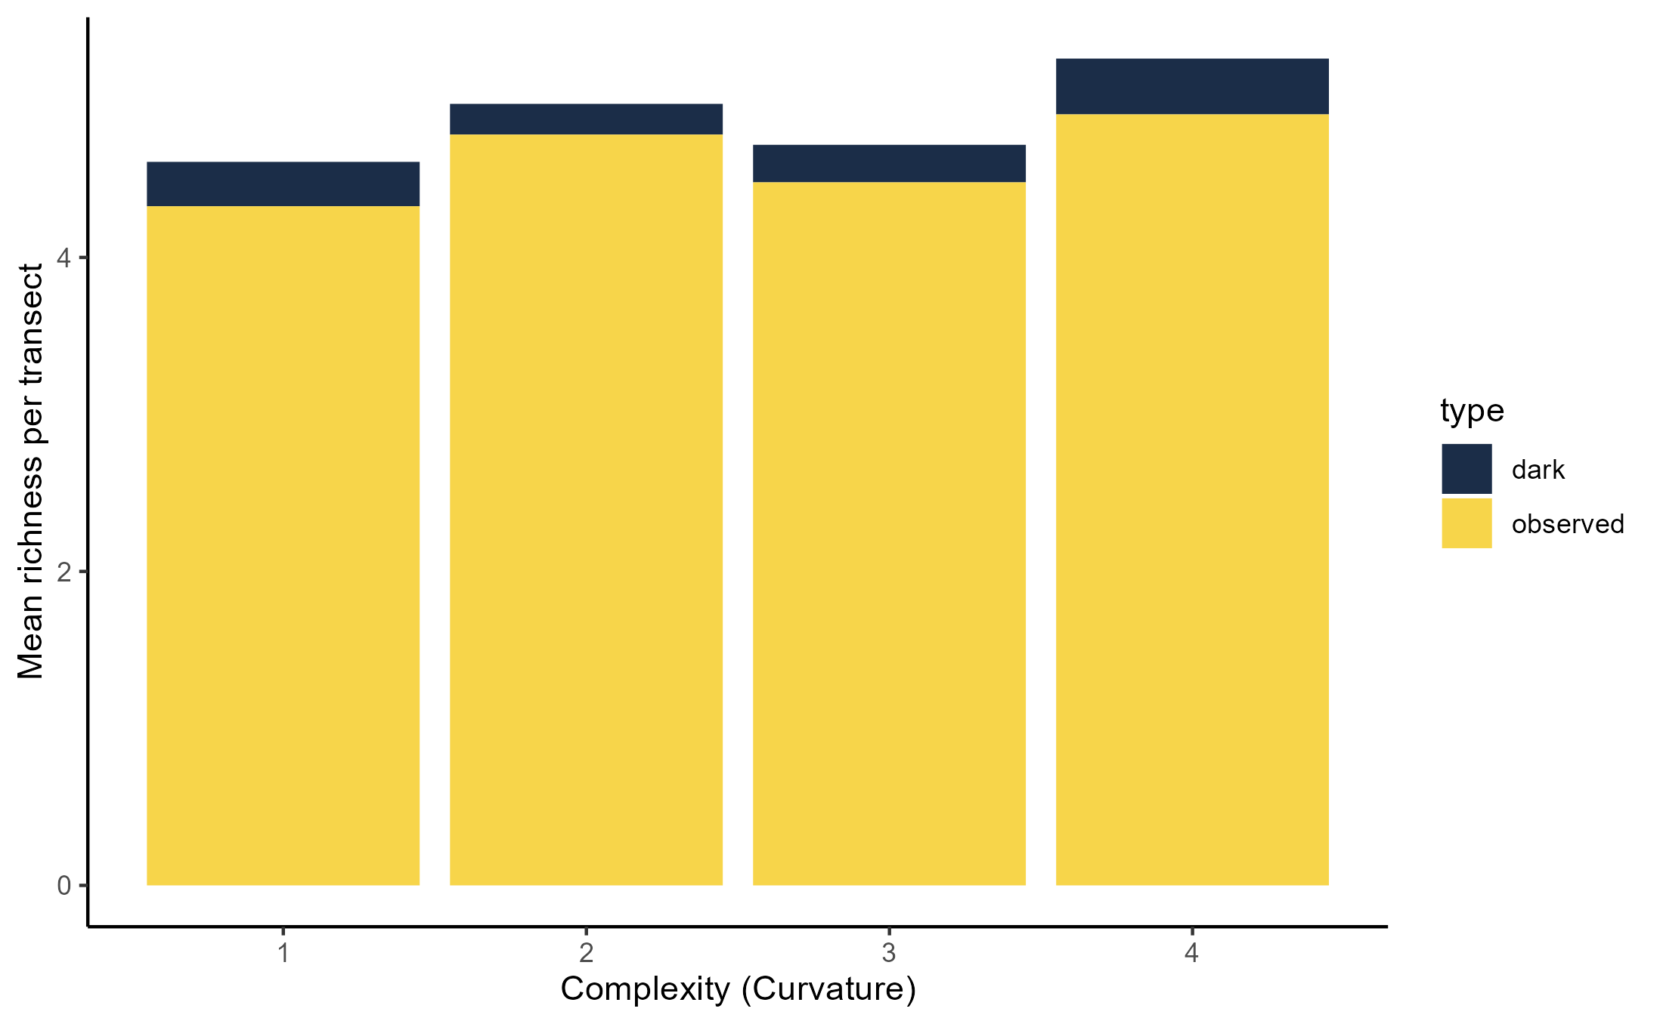
Species pool and complexity – Curvature

